Slide 1

Application: QuickFeed Type: Application Architecture View: Logical View Style: Layered Architecture Pattern
Users
Deliver Channels
Core Business Processes
Data And Information
Technology Enablers
Messaging Bus
User Account
User’s data
Google API
User’s Personal
Website
Service Provider Account
Service provider data
Real-time Bus
User & Service providers
Home
Order Data
Subscription Data
Service provider listing/ Categories
filtering Data
E-Payment
Shopping Cart
Internet
Search
Transactions
Email
Explore
Admin
Suggestions/
Ads
Payment Information
B2B-getaway(SaaS)
Help Desk

Slide 2
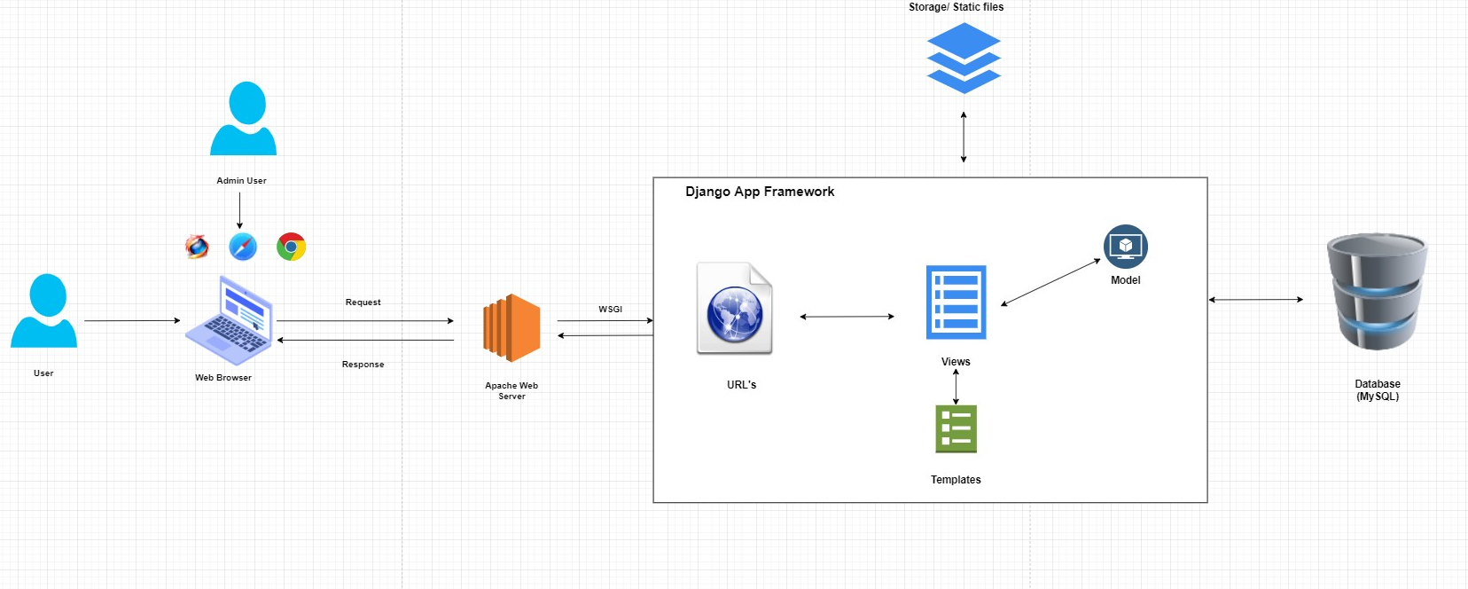
Application: QuickFeed Type: Application Architecture View: Process View Style: Client-Server Pattern

